Slide 1
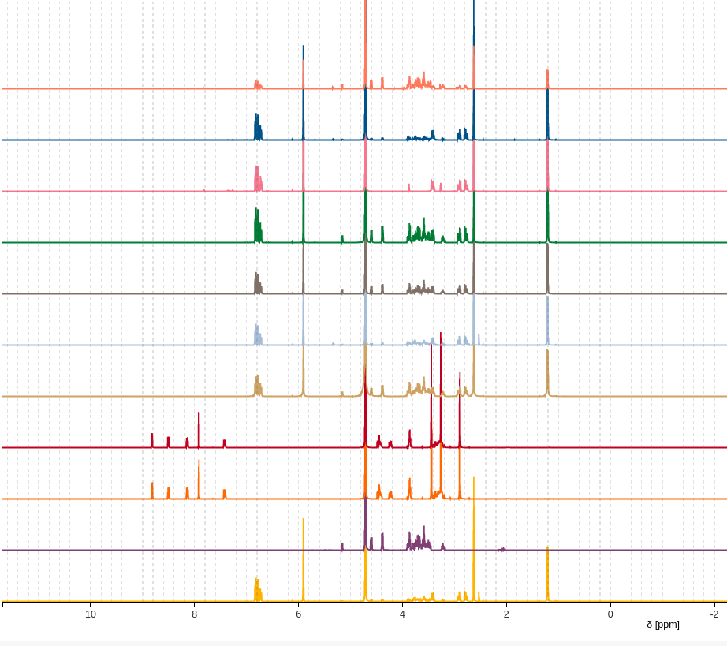


Introduction to data preprocessing
Reika Masuda
September 2025

Slide 2
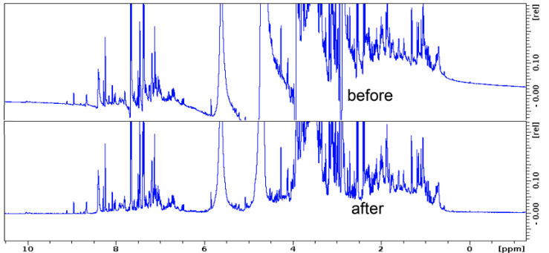
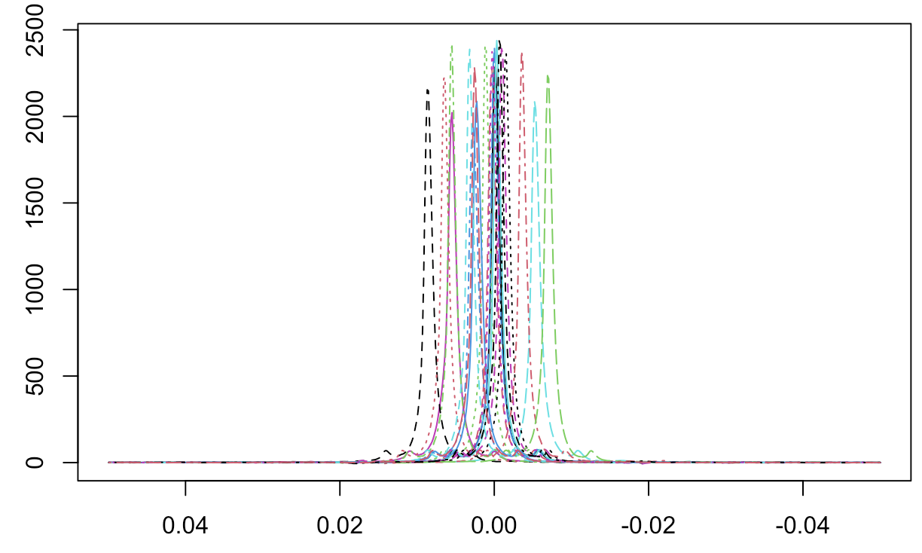
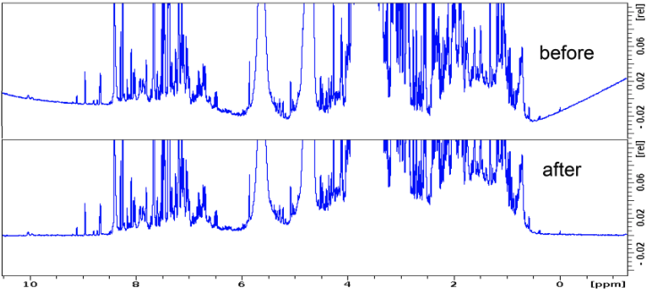
Why Data Processing Matters
Noisy spectra
Experimental artifacts
Reproducibility and interpretability
Can impact downstream statistical analysis and biological interpretation
Emwas et al (2018)

Slide 3
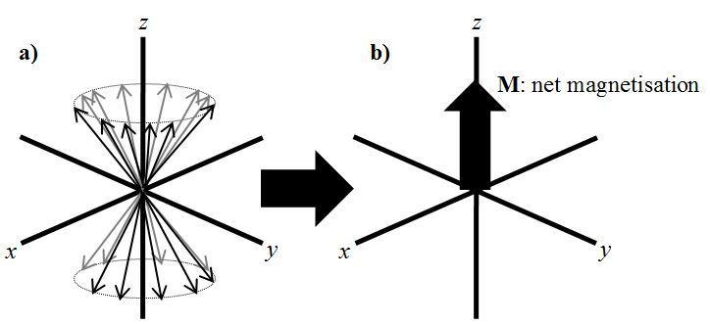
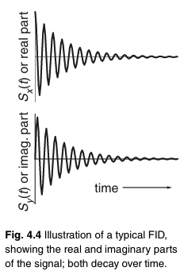
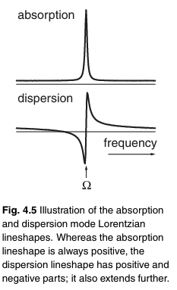
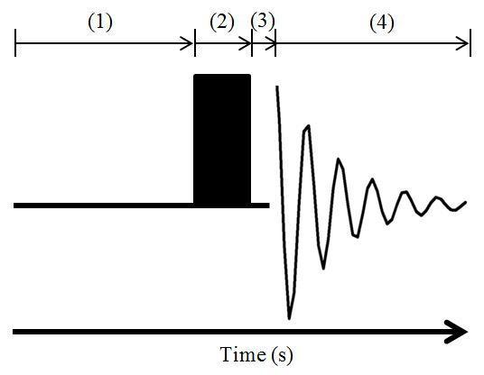
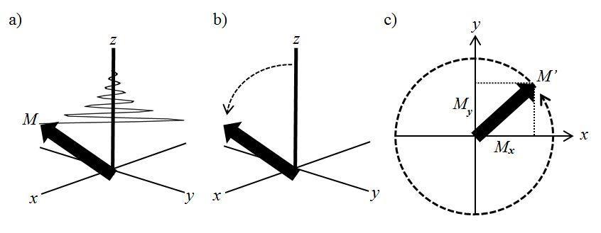
NMR Data Acquisition Basics
Magnetisation
FT
FT
Radio Frequency Pulse

Slide 4
NMR Data Acquisition Basics
Frequency conversion: down-mixes RG signal to lower frequency
Filtering to remove out-of-band noise and artifacts
Signal is conditioned for digitization
RF Synthesizer
Receiver Chain
Generate precise Radio Frequency (RF) waveform at the Larmor frequency
Defines pulse shape, phase and duration
First stage of signal amplification
very low-noise design to keep low signal-to-noise ratio (SNR)
Located close to the probe to minimize signal loss
Boosts RF pulse power (watts → kilowatts)
Provide enough energy to tilt nuclear spins
RF Power Amplifier
Pre-Amplifier
During transmission: excite nuclei in the magnetic field
During receiving: detect the FID (tiny voltage from precessing spins)
Probe tuning and matching to optimise sensitivity (this part is done before running the sample)
Routs RF power to the probe during transmission
Immediately switches off to protect receiver after pulse
Direct weak FID signal from probe to the pre-amp
Duplexer
Probe Coil

Slide 5
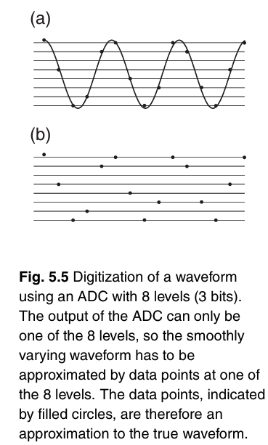
NMR Data Acquisition Basics
User-adjustable amplification before digitization
To Protect Analog-to-Digital Converter (ADC) from clipping
Optimise the ADC dynamic range usage
RF Synthesizer
Receiver Chain
Receiver Gain (RG)
RF Power Amplifier
Pre-Amplifier
Analog to Digital converter (ADC)
Store raw FID data
Perform digital signal processing (FT, Phase etc.,)
Duplexer
Probe Coil
Consol
NMR Spectrum

Slide 6
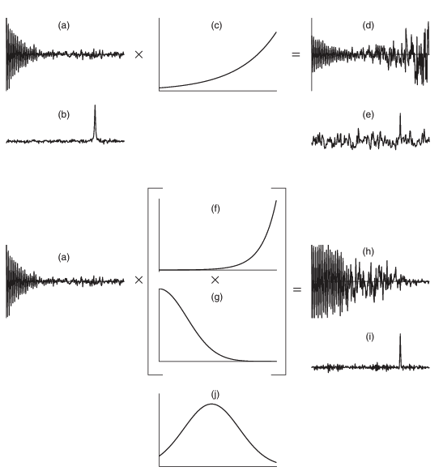
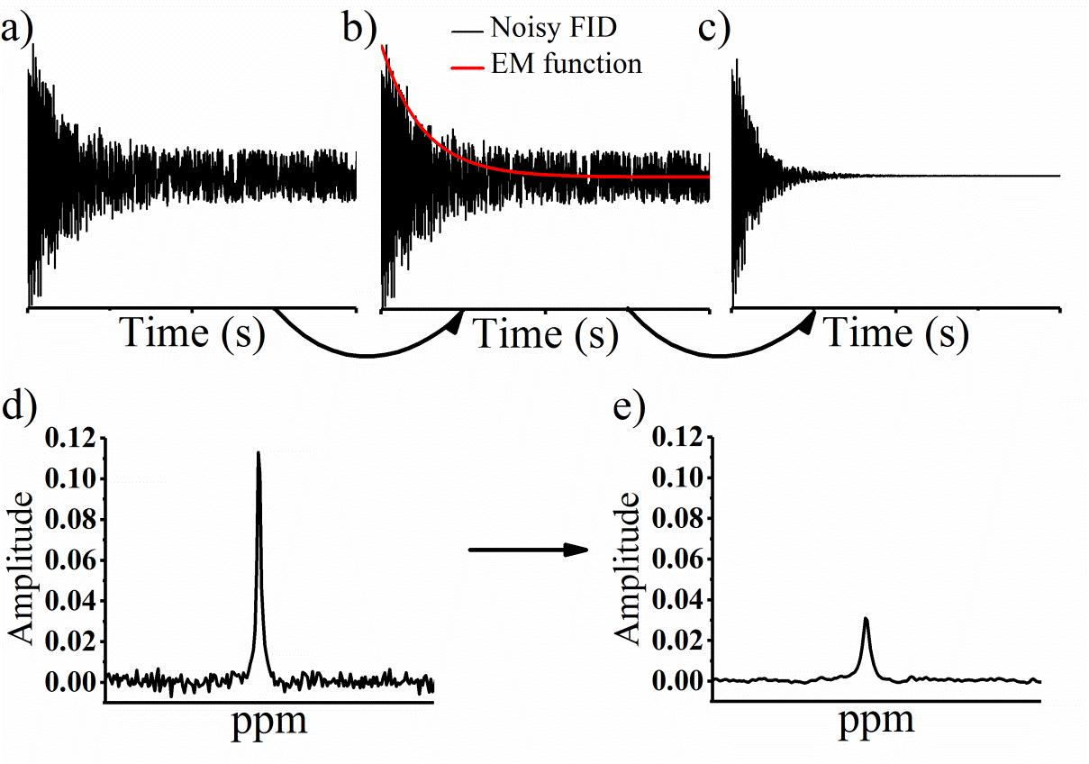
Steps Before FT: Window function
A window function is used to smooth the FID to remove the sudden cutoff at the end of the FID so that the data drops to or close to zero intensity before ZF.
Without the window function, the sharp ending of the signal causes base oscillation called truncation artifacts.

Slide 7
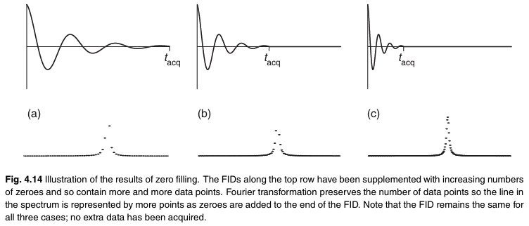
Steps Before FT: Zero filling
Zero filling (ZF, appending zero-value data points to the FID) is almost always done before FT to increase digital resolution of the FT spectrum.
Typical acquisition time of an FID for a small molecule is ~ 5X of the longest T2 among the spins. Often, 2-3 secs is adequate.
ZF is often applied to at least double the original FID data size.
Further zeros appended often only increase the smoothness of the spectrum without further gain in resolution.

Slide 8
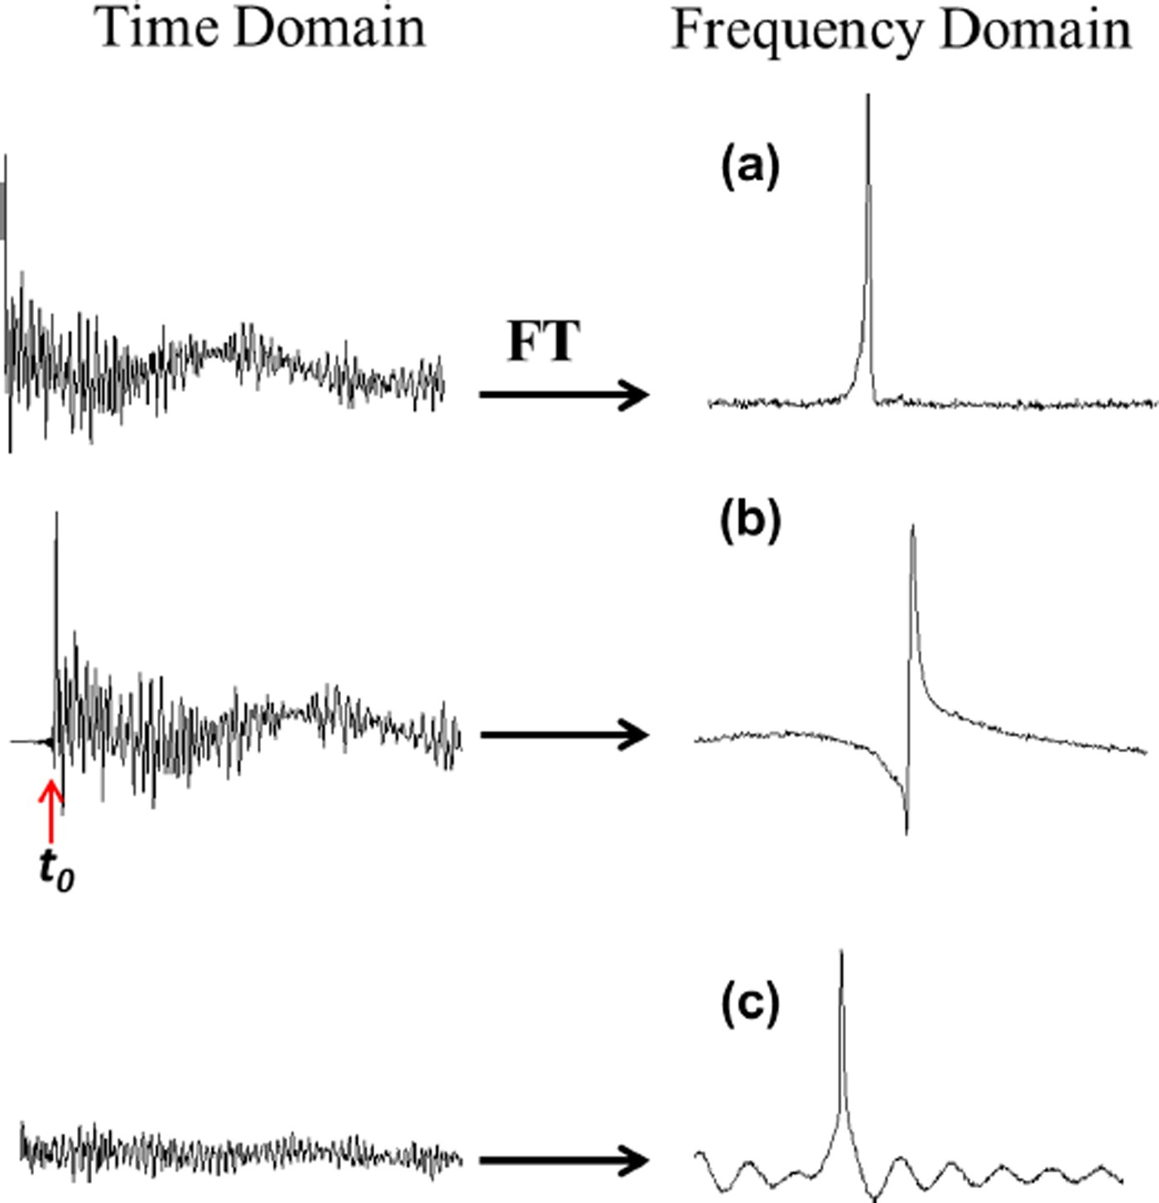
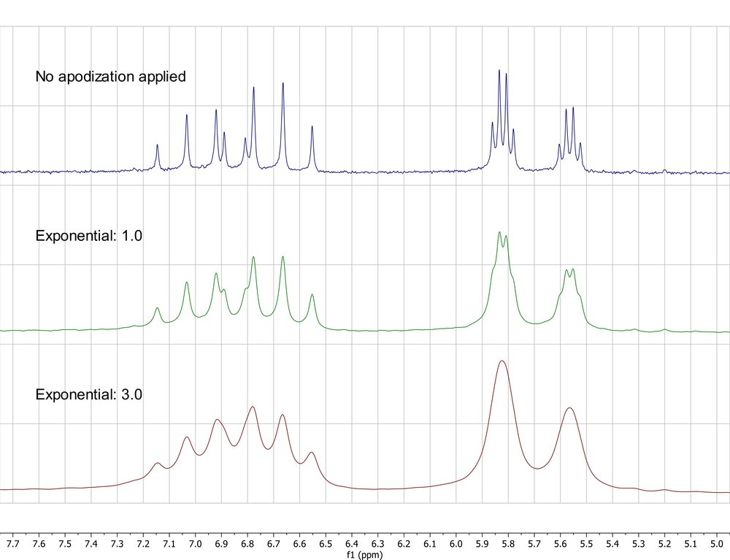
Common NMR Artifacts and Errors
* Baseline distortions
* Phase errors
* Water suppression artifacts
* Aliasing/folding
* Spinning sidebands
* Poor shimming / line broadening
_{Less overlap}
_{More sensitive to shifts}
_{Line broadening}
_{More overlap}
Emwas et al (2018)

Slide 9
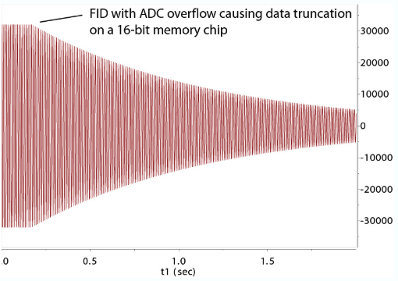
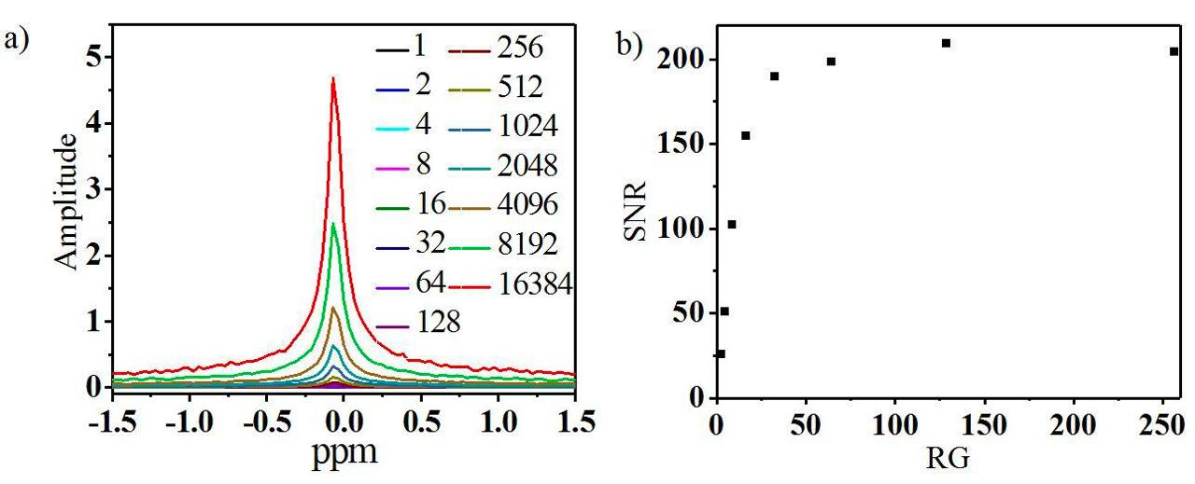
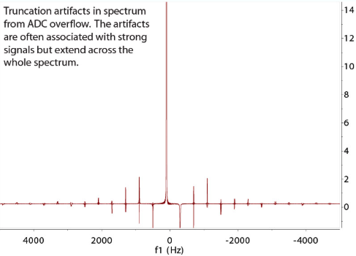
Truncation Artifacts from Digital Overflow
Main Cause: setting receiver gain too high

Slide 10
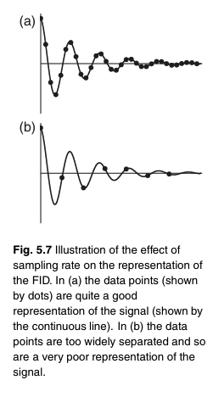
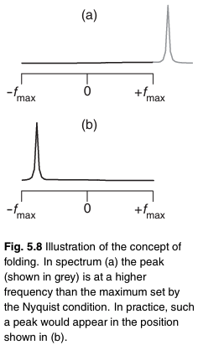

Signal Folding
Nyquist theorem:
sampling rate (Δ) must be at least twice as fast as the highest frequency (Nyquist frequency, f_{max} ) present in that signal
f_{max} = 1/2Δ
Δ = 1/2f_{max}
sampling rate is also known as dwell time
when sampling rate is too slow, the signal frequency that is higher than your nyquist limit get folded back into the spectrum at lower frequency (Fig. 5.8) → folding

Slide 11
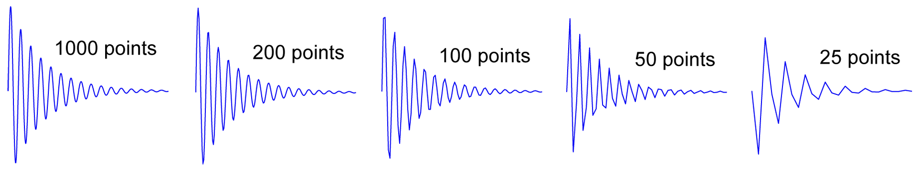
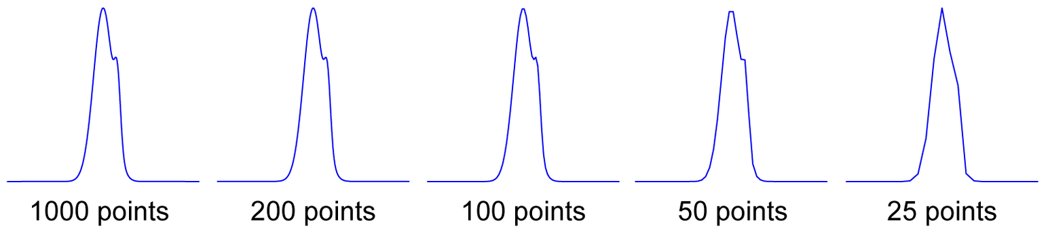
Sampling rate and Resolution

Slide 12
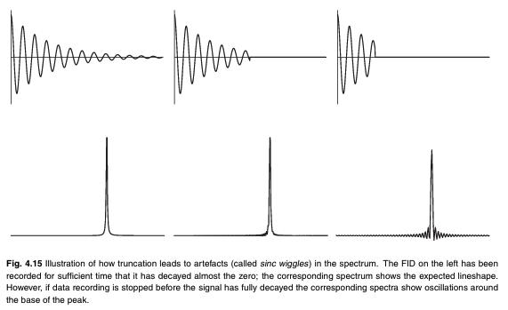
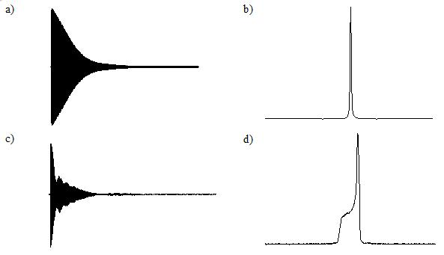
Spinning sideband
Shimming and spectra shape
Appropriate acquisition time
Acquisition time is too short
AQ = 4 sec
AQ = 2 sec
AQ = 1 sec

Slide 13
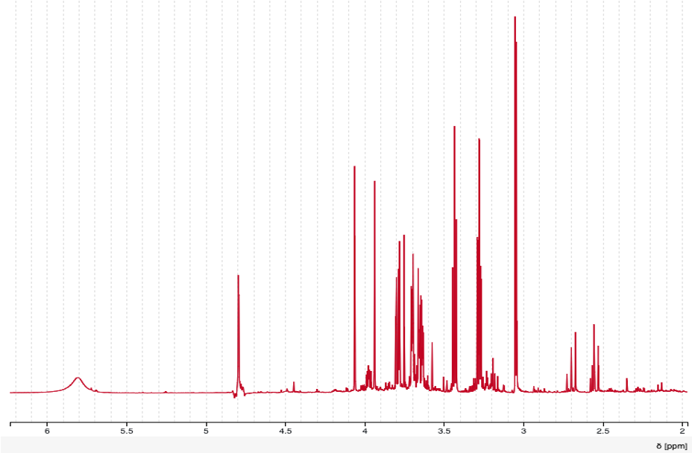
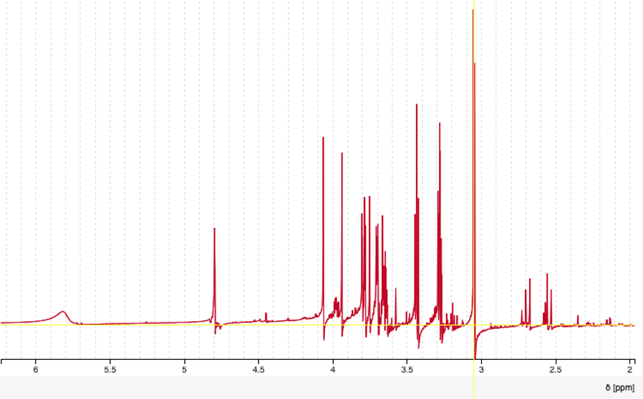
Phase Correction

Slide 14
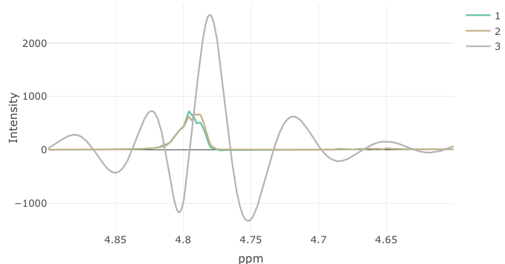
Water suppression failure
Possible cause:
Low sample volume?
Wrong solvent (matrix)?
Bad shim?
forgot to mix it well?
Floating sentiment ?
Air bubbles in the tube?

Slide 15
Artifacts (instrumental/Processing)
Experimental Failures
Summary
Baseline distortions → curved/sloping baseliane
Phase errors → dispersive peak shapes
Water suppression artifacts → residual water & sidebands
Aliasing / Folding → signals fold back into spectrum
Spinning sidebands → peaks symmetric around intense resonance
Striping in 2D → noise from electronics/sample instability
Poor shimming → broad, unresolved peaks Pulse miscalibration → distorted multiplets, weak signals Receiver gain issues → saturation or low sensitivity
Temperature instability → shifting chemical shifts, broadening
Magnet drift → peak wandering, poor reproducibility
Short relaxation delays → quantification errors

Slide 16
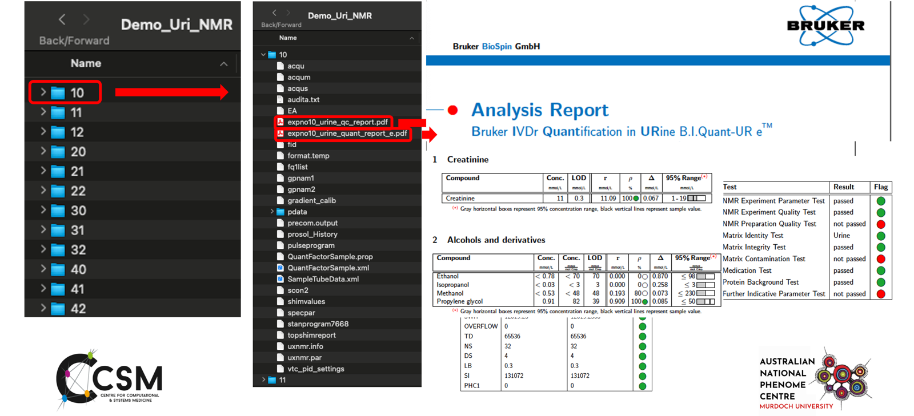
What is in your NMR Data folder?

Slide 17
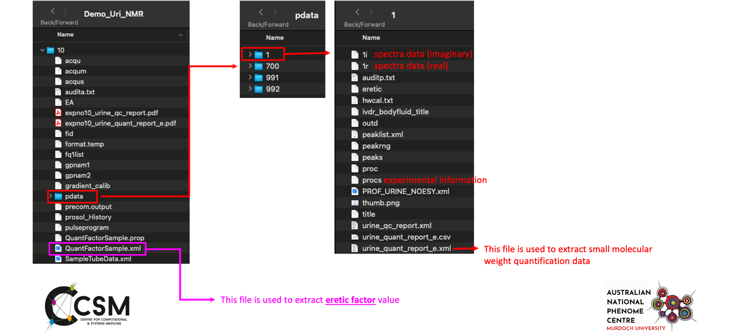
What is in your NMR Data folder?

Slide 18
Overview of NMR Spectra pre-processing steps
(1D and CPMG)

Slide 19
Overview of NMR Spectra pre-processing steps
Apply ERETIC factor correction
Spectra Alignment/Calibration
Remove following ppm range
0.5 and higher field (TSP)
4.6 ~ 5.0 residual water signals
9.5 and lower field
Baseline correction
Normalization

Slide 20
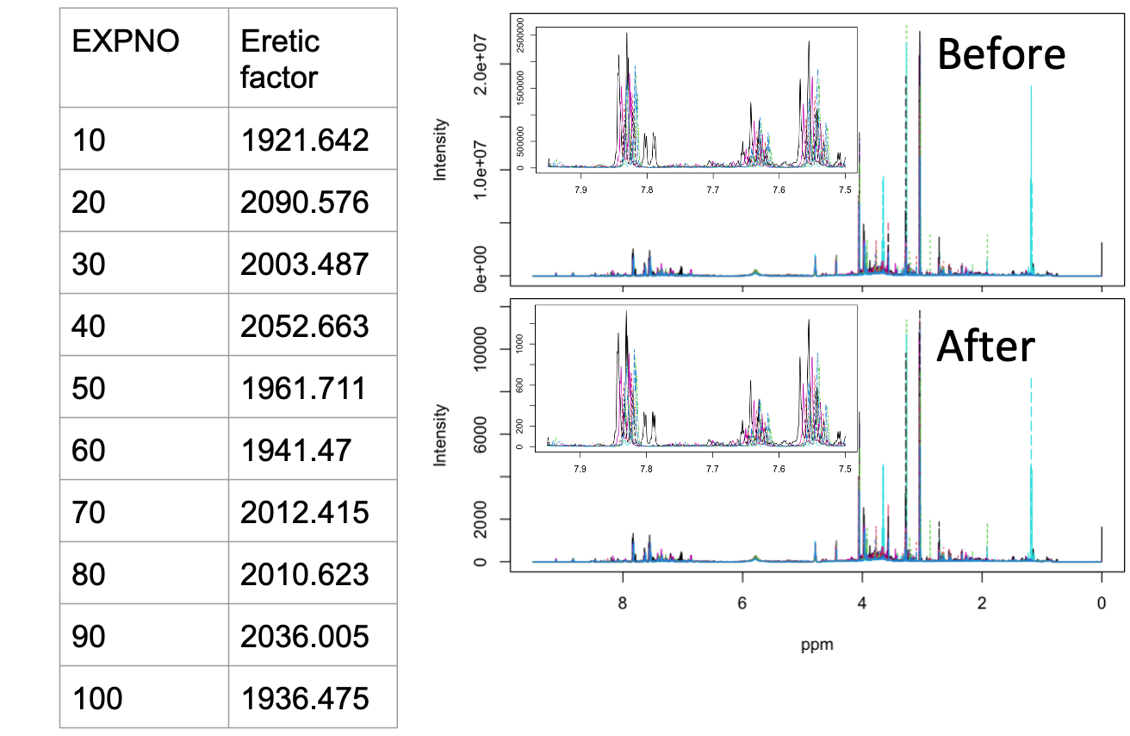
ERETIC factor correction

Slide 21
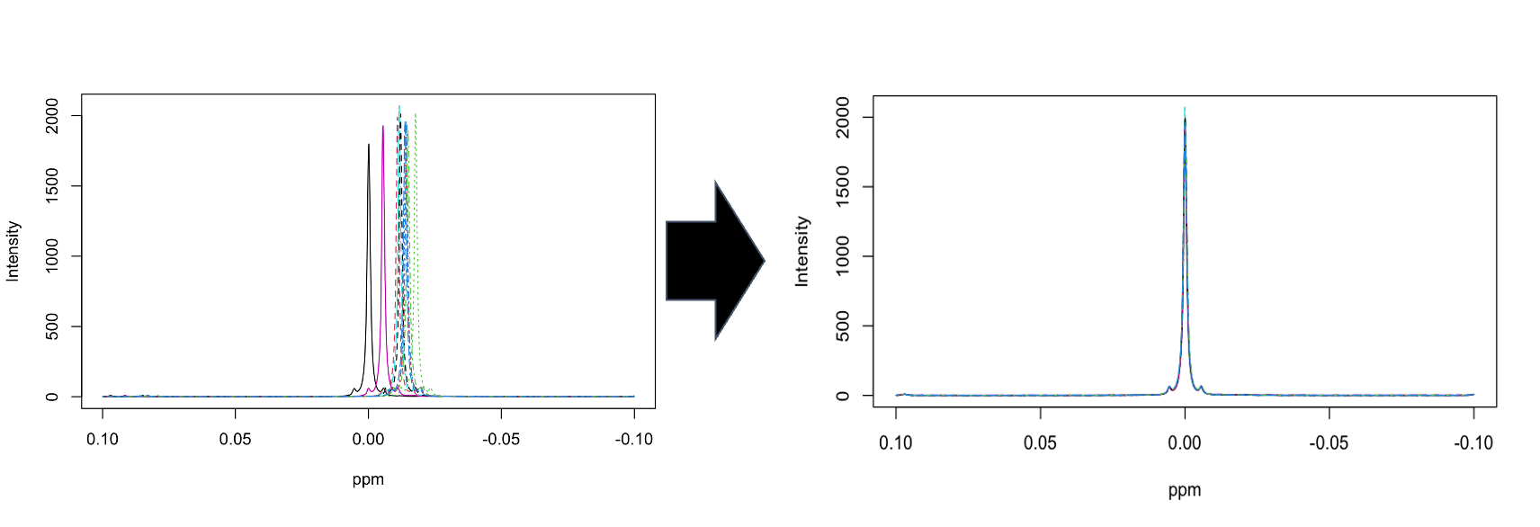
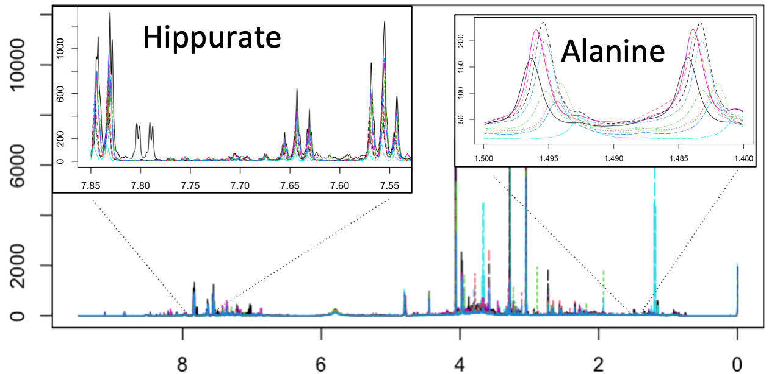
Spectra calibration/Alignment

Slide 22
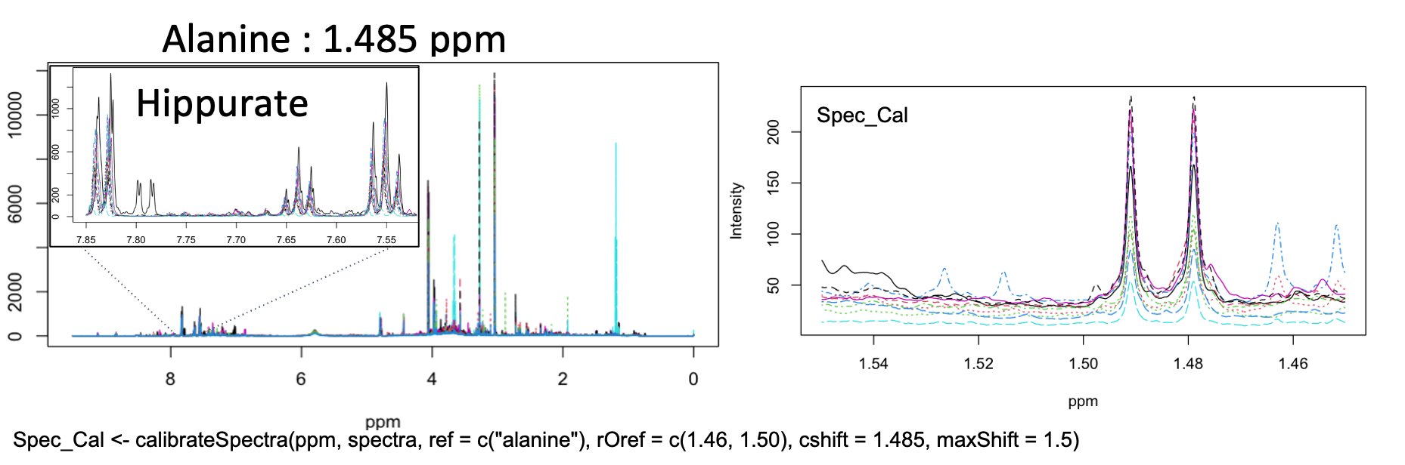
Spectra calibration/Alignment

Slide 23
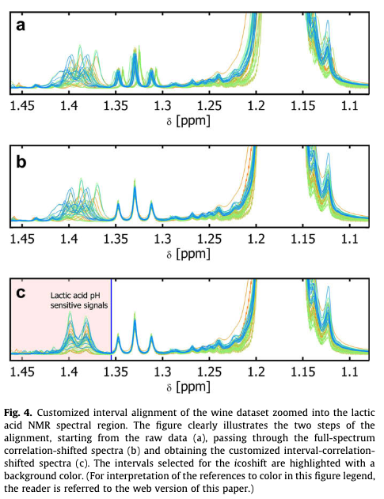
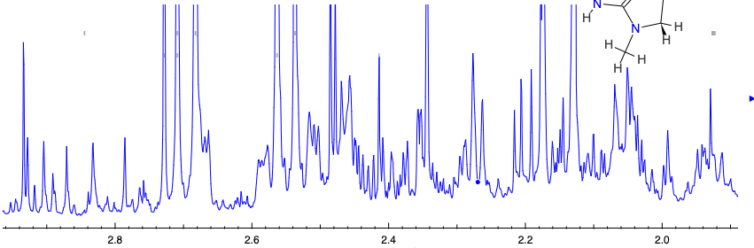
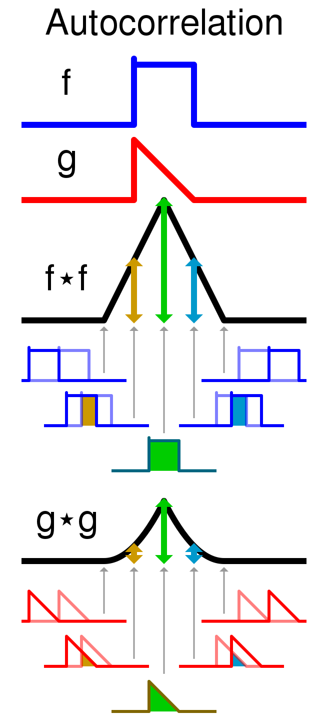
Alignment, or not?
Calibration is relative to the type of matrix to study and will impact the whole analysis
There is no “universal” calibration that fits all problems
If you are certain about what you are aligning, then you may as well quantify it…
But if you were to align this is the moment, before normalization

Slide 24
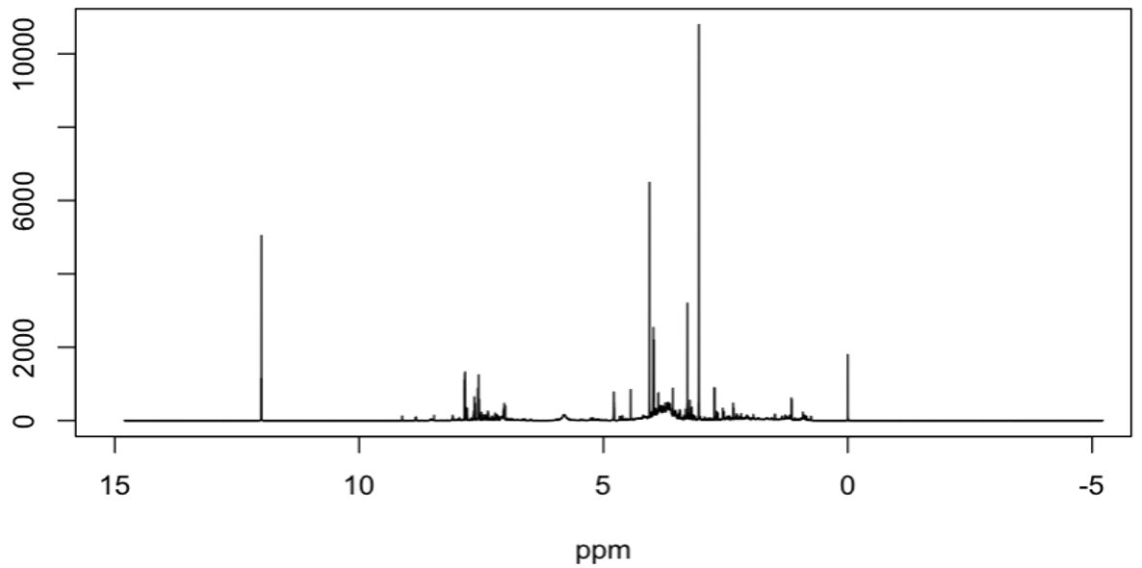
Remove water residuals and other regions with no signals
0.5 and higher field (TSP)
4.6 ~ 5.0 residual water signals
9.5 and lower field
Note: urea region (5.5 ~ 6.1 ppm) is often recommended to be removed as part of the pre-processing.

Slide 25
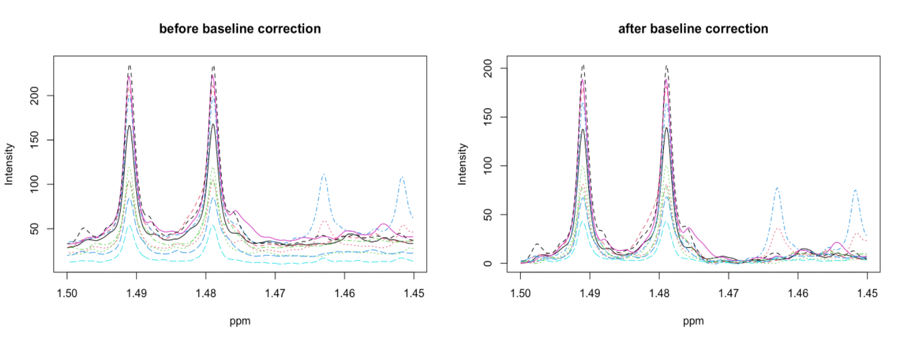
Baseline correction

Slide 26
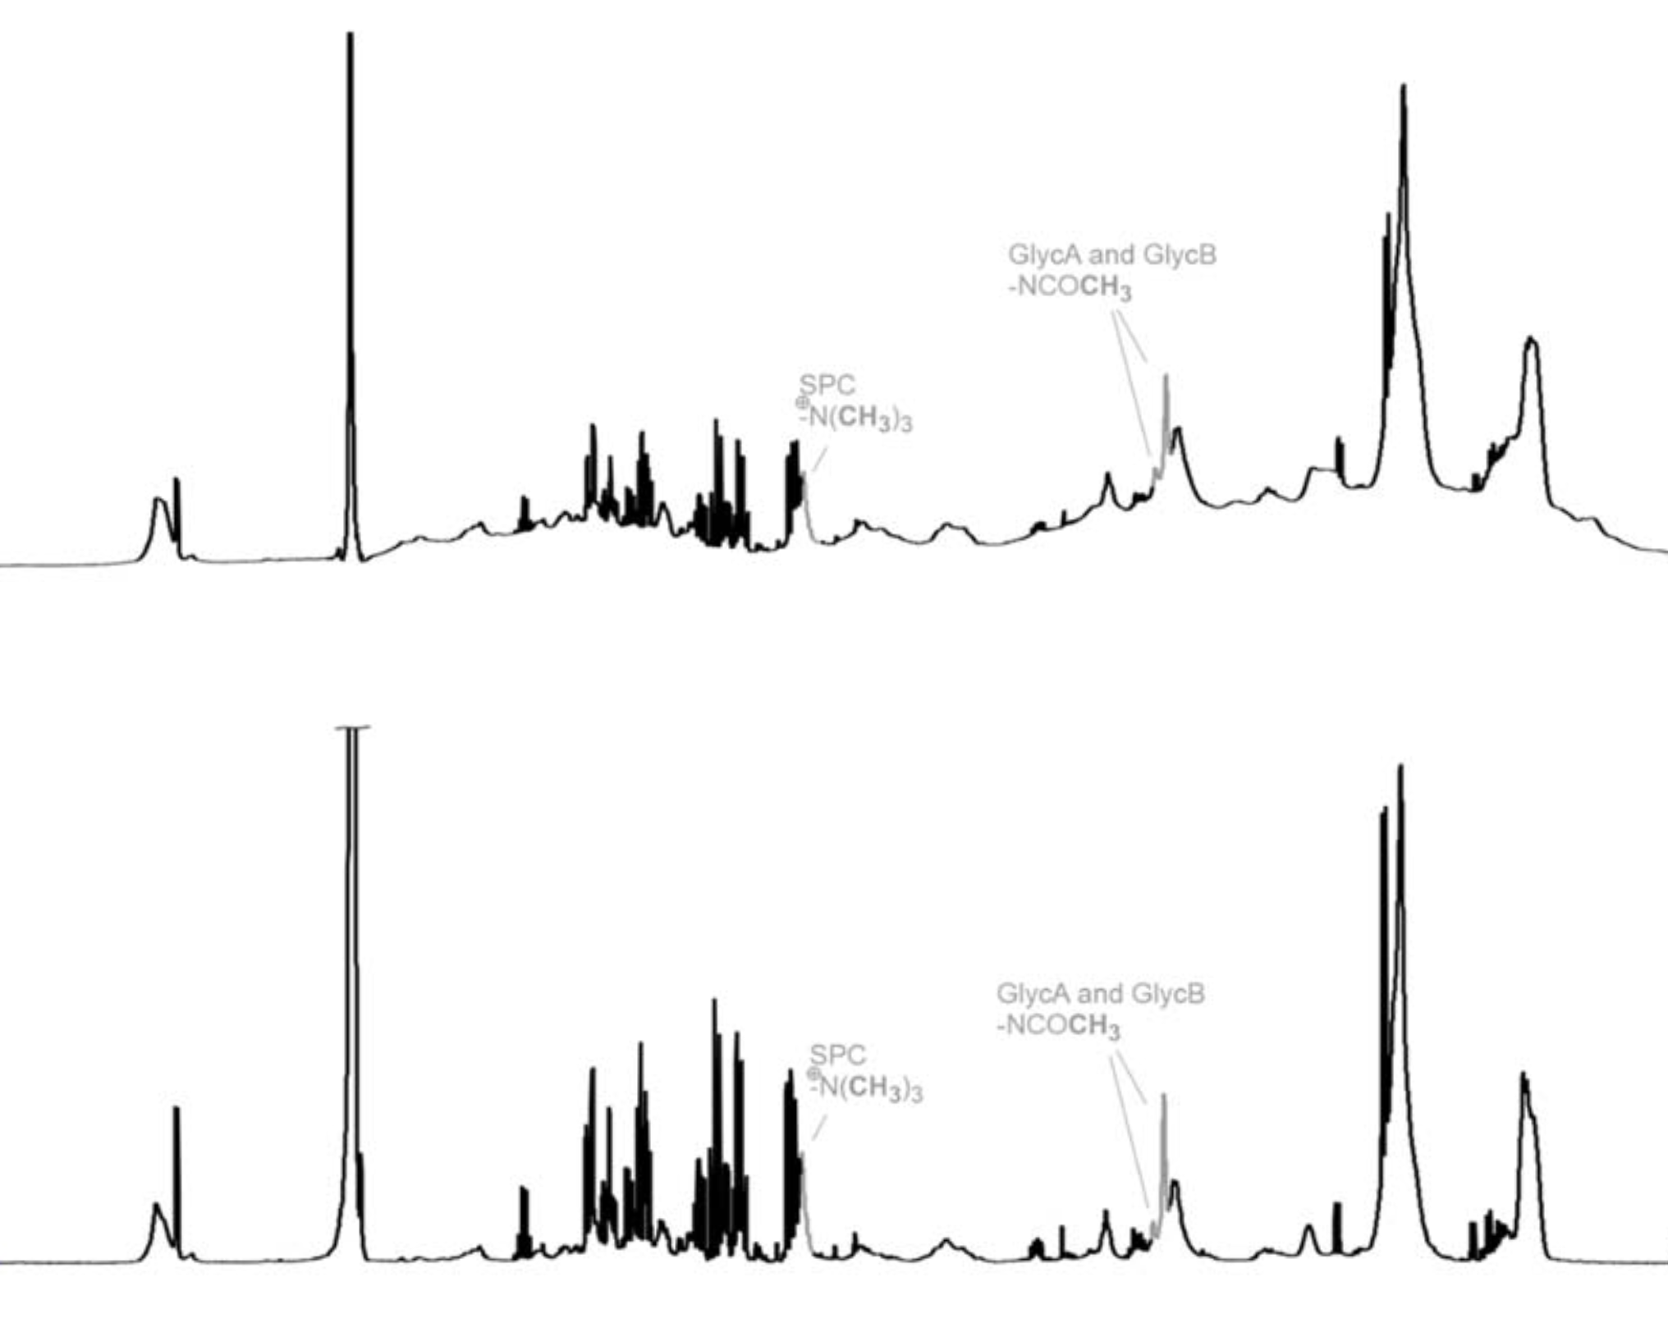
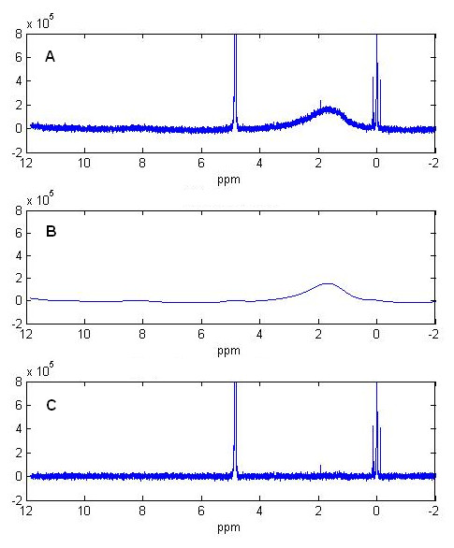
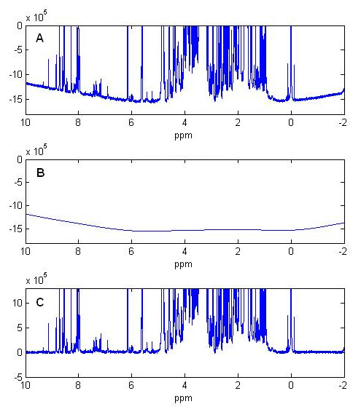
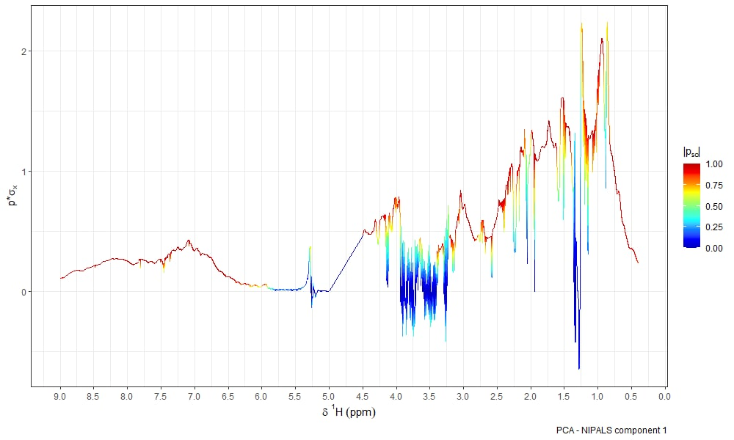
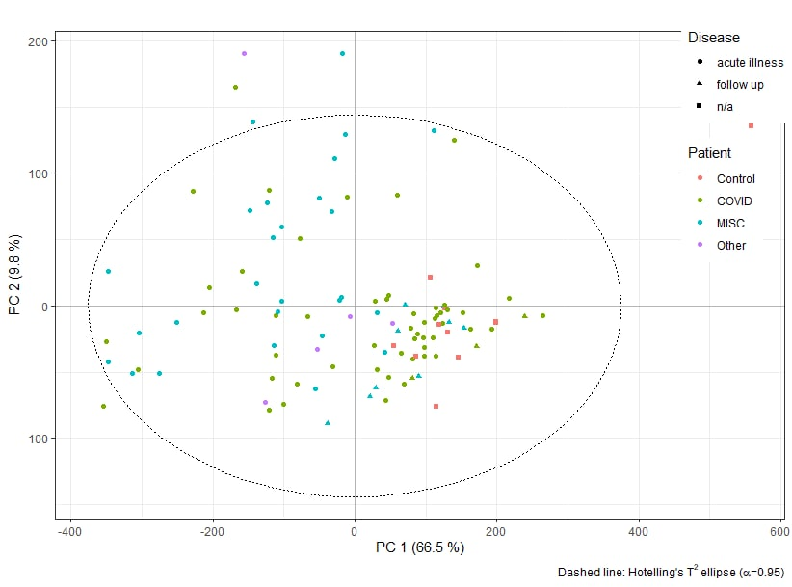
Baseline correction depends on being able of distinguishing true signals from noise
Time domain baseline correction to restore corrupt points
Frequency domain baseline correction to subtract from the spectra
https://doi.org/10.3109/00365513.2014.1003593
DOI:10.1186/1471-2105-9-324

Slide 27
Normalization works against external or internal references and depends on the experimental design and type of data
The meaning of normalization is context dependent.
In mathematics it means dividing a tensor by its norm.
In statistics it refers to as making a sample follow a normal distributions.
In metabolomics it refers to as making specimens look similar by multiplying by a correction factor (scaling in statistics)
Method | Abbr. | Description | Remarks | References
Urine output (Elizabeth R. Lusczek et al., 2013b) | UO | Urine output is the volume of urine excreted per hour per kilogram of mass. Normalization is performed by multiplying raw metabolite concentrations by urine output | Total urine output may be difficult to obtain | Lusczek et al. (2013a)
Osmolality | OSM | Osmolality is the concentration of solute particles in the urine. Normalization is carried on by dividing concentration by the osmolality of each sample, returning | It reflects physiological metabolite-concentrating mechanisms in the kidneys | Lusczek et al. (2013a)
 |  |  | Require intensive lab work
Normalization to an internal standard | IS | The concentration of each metabolite is divided by the concentration of an internal standard, usually creatinine | Constant excretion of creatinine into urine (creatinine clearance) is assumed to be constant. Exact creatinine concentration may be difficult to estimate from NMR spectra | Jatlow et al. (2003)
Constant sum (1) | SC | Metabolites concentration are divided by the sum of the concentration for all the measured metabolites | Assumes that the concentration of each metabolite is increased by the same amount due to the increased concentration of the urine sample | Lusczek et al. (2013a)
Constant sum (2) | SC-LUG | Same as CS but lactate, glucose, and urea concentrations are excluded | Implies that lactate, glucose, and urea concentrations are highly variable during the experiment | Lusczek et al. (2013a)
Total spectrum area | TSA | The (binned) spectra are summed over the entire spectral area excluding regions containing water and urea resonances | See CS and CS-LUG | Lusczek et al. (2013a)
Probabilistic quotient normalization | PQN | It starts with an integral normalization of each spectrum, followed by the calculation of a reference spectrum (median or baseline). For each variable of interest the quotient of a given test spectrum and the reference spectrum is calculated and the median of all quotients is estimated. All variables of the test spectrum are then divided by the median quotient | It assumes that biologically interesting concentration changes influence only parts of the NMR spectrum, while dilution effects will affect all metabolite signals. Choice of reference spectrum is arbitrary | Dieterle et al. (2006)
Cyclic loess normalization | Loess | The log-transformed ratio of any two spectra is compared to their average feature by feature; then, a normalization curve is fitted using non-linear local regression (loess) and subtracted from the original values | Assumes the presence of non-linear biases, such as intensity-depended biases, is assumed | Dudoit et al. (2002; Cleveland and Devlin, 1988)
Contrast normalization | Contrast | By means of an orthonormal transformation the matrix into a transformed onto a contrast space. Normalizing curves are fitted similarly to those in Cyclic Loess Normalization, using a robust distance measure based on the Euclidean norm. The contrasts are evened out by a smooth transformation and data are mapped back to the original input space | Cyclic loess normalization | Åstrand (2003)
Quantile normalization | Quantile | All spectra are brought to an identical distribution of intensities across features (bins or metabolites). quantile | After QN the vectors of feature intensities consist of the same set of values, however, these values are distributed differently among features | Bolstad et al. (2003)
Linear baseline normalization | Linear | A scaling factor is used to map linearly from each spectrum to the baseline. The scaling factor is computed for each spectrum as the ratio of the mean intensity of the baseline to the mean intensity of the spectrum | It assumes a constant linear relationship between each feature of a given spectrum and the baseline | Bolstad et al. (2003)
 |  |  | Baseline is arbitrary: it can be constructed by calculating the median of each feature over all spectra
Non-linear baseline normalization | Li-Wong | A normalization curve is fitted to map a spectrum to the baseline spectrum (having the median overall intensity) on a scatter plot. The normalization curve is fitted only on non-differentially expressed features which are used for finding the normalizing piecewise linear running median line | It is assumed that features corresponding to unregulated metabolites have similar intensity ranks in two spectra. Possible non-linear relationships between the baseline and the individual spectra are also assumed | Li and Wong (2001)
Cubic-spline normalization | Spline | A baseline spectrum is built by computing the geometric mean of the intensities of each feature over all spectra | The existence of non-linear relationships between baseline and individual spectra are assumed | Workman et al. (2002)
 |  | A set of evenly distributed quantiles is taken from both the target spectrum and the sample spectrum and used to fit a smooth cubic spline. The process is iterated several times shifting the set of quantiles by a small offset each time. Finally a spline function generator uses the generated set of interpolated splines to fit the parameters of a natural cubic spline | The geometric mean can be substituted by the arithmetic mean for reasons of robustness to negative values
Shapiro–Wilk | SW | Features showing high variability in concentration are iteratively removed until mostly nonregulated features remain. These are be used as reference features for subsequent data normalization | It assumes that the variance of regulated features across all specimens is larger than that of nonregulated features | Hochrein et al. (2015)
Linear mixed | LM | It fits a mixed model to metabolite concentration with simultaneous estimation of the correlation matrix | Assume data as coming from a larger pool cohorts; same for the batches and samples | Jauhiainen et al. (2014)
EigenMS |  | Estimating treatment effects with an ANOVA model; singular value decomposition of the residuals matrix is then used to determine bias trends in the data. The number of bias trends is then estimated via a permutation test and the effects of the bias trends are eliminated | Not tested on NMR data | Karpievitch et al. (2014)
Variance stabilization normalization | VSN | VSN approaches are set of non-linear methods that used to keep the variance constant over the entire data range, leading to roughly equal variable variance. Found to work well with NMR data | Found to work well with NMR data | Huber (2002)
Emwas et al., Metabolomics 2018 14(3) 1-23

Slide 28
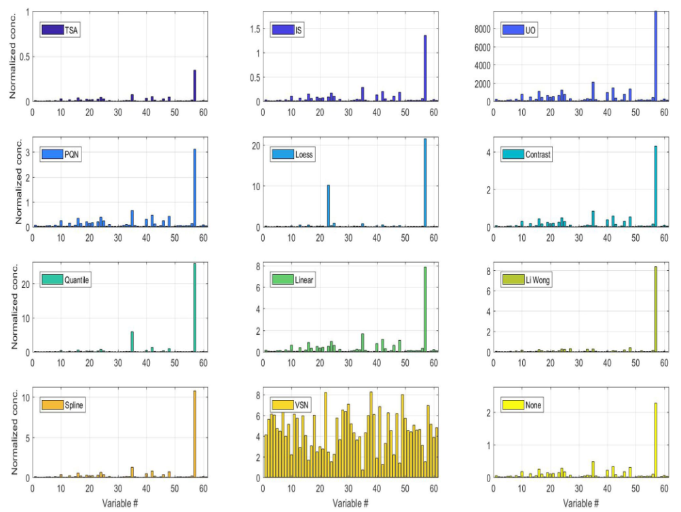
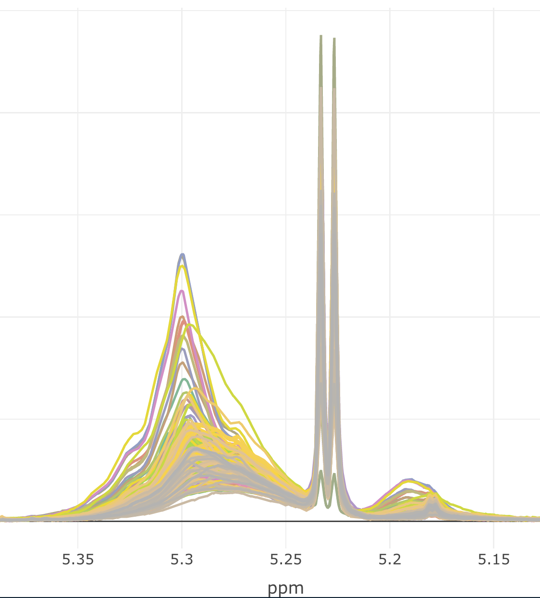
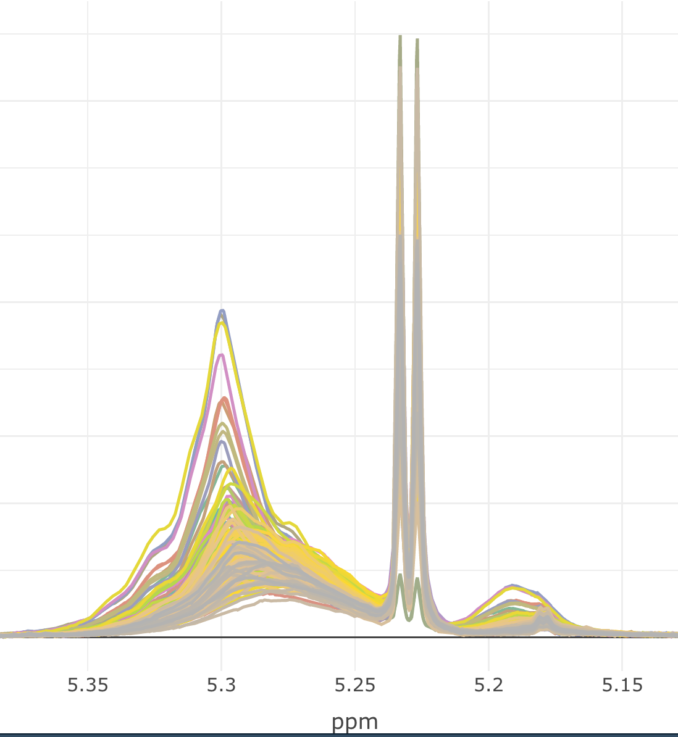
Normalization are either physiological if we have access to extra measurements or numerical
Probabilistic Quotient Normalization
Divided by
Different normalization strategies, IS, UO, and osmolality are physiological, while all others are numerical
Internal standard
Creatinine
Urinary output
Divided by
Before
After
Analytical Chemistry, Vol. 78, No. 13, July 1, 2006

Slide 29
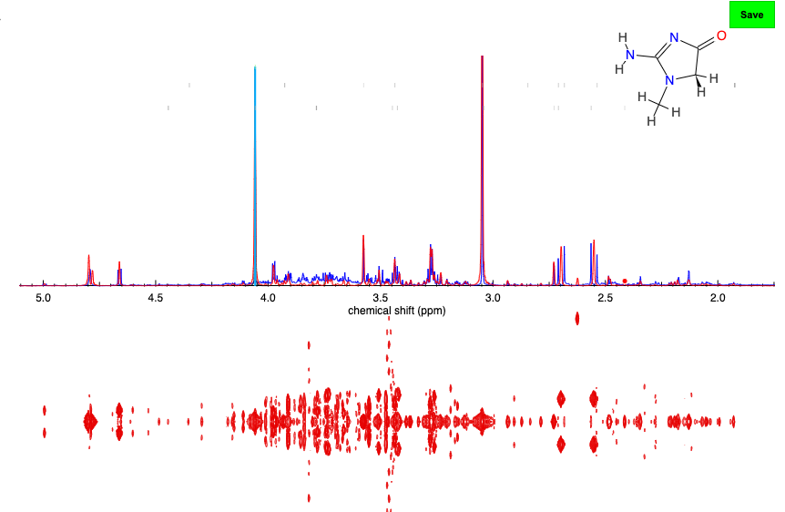
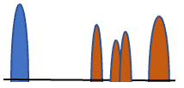
Normalization to internal standards
Normalization to external standards
Creatinine
ERETIC peak
Peaks of compounds of known concentrations
ERETIC peak
Peaks of compounds of unknown concentrations
Creatine can also be measured externally. It is a widely use methods in clinical research as a lot of markers are reported as ratios to creatinine, instead of concentrations.
It is a good normalization strategy as long as the we don’t expect the phenomenon under study to affect the release of creatinine in urine.

Slide 30
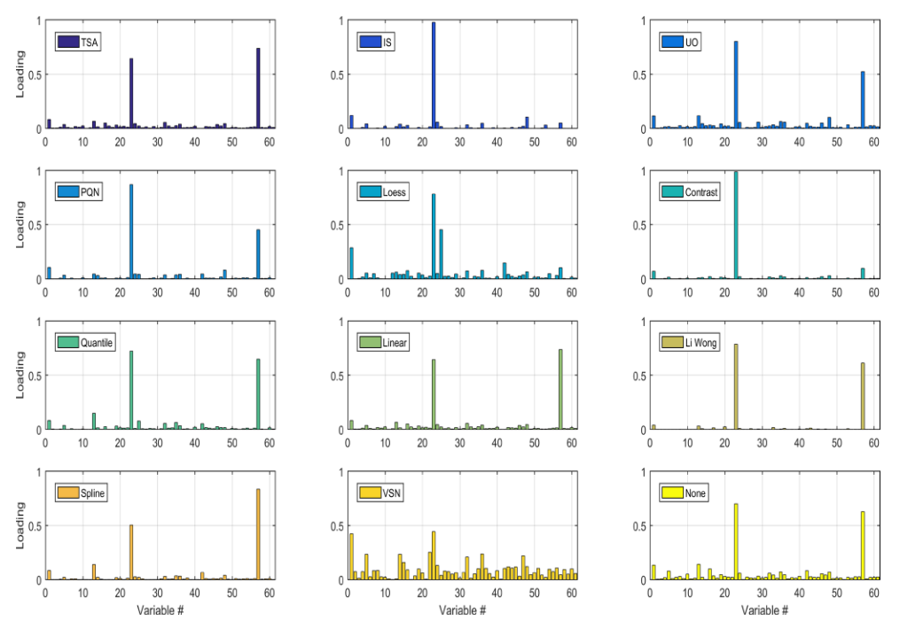
Normalization will affect our interpretation of the models
Normalization will also correct for batch effects under certain circumstances
Probabilistic Quotient Normalization will correct for batch effect that translate into global increase or decrease of concentrations
Divided by
Divided by
Divided by
Divided by

Slide 31
Quality check of your data/experiments before analyzing

Slide 32
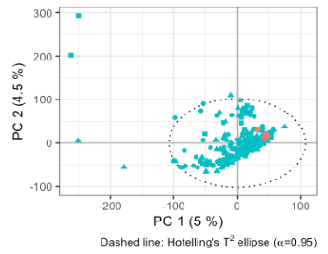


LTR and outliers
You need to do LTR check in every data set.
We usually run principal component analysis (PCA) to check if all the LTRs are in the tight cluster.
We also check all the samples are equally spread out in the first 2 principal component regardless of plates and instruments.
For spectra, make sure to do post-processing before PCA.
LTR outlier:
Issue : Bad Shim
Keep in mind that back in the day…. You had to check shim and correct phase manually before data transport
Urine noesy data as an example

Slide 33



Line width test from the QC report
Plasma/Serum
Urine
If the line width test failed, (e.g., LW >2.0 Hz)
Check the NOESY around 1.48 ppm look for Alanine doublet peak in NOESY, in most cases the peak is not found → Line width test failed.

Slide 34


Alanine peak shift from the QC report
in Plasma and Serum sample
1.47 ~ 1.52 ppm
Samples that failed both tests
Samples that failed only alanine test

Slide 35



TSP concentration from the QC report
in Urine sample
-0.1 ~ 0.1 ppm

Slide 36








Sample issue?
Haemolysed plasma

Slide 37



Sample issue?
https://doi.org/10.1021/acs.analchem.2c02167
Plots from Sam L.

Slide 38

Quality Control – Why?

Slide 39

Quality Control – How?

Slide 40

Pooled QC Samples

Slide 41

Batch Correction

Slide 42



Slide 43

Assessment of Peaks

Slide 44

Peak Assessment

Slide 45

Peak Assessment

Slide 46

Missing Values and Imputation
Types of missingness:
Missing Completely At Random (MCAR)
Missing At Random (MAR)
Missing Not At Random (MNAR)

Slide 47
Commonly used imputation methods
Random Forest (RF)
Ensemble machine learning method (many decision trees).
Non-parametric → no assumptions about data distribution.
Captures non-linear relationships and variable interactions.
Used for imputation by predicting missing values from observed data.
Works well with mixed data types (categorical + continuous).
missForest
Specific RF-based imputation algorithm.
Steps:
Start with initial guess for missing values.
Iteratively train Random Forests to predict missing entries.
Repeat until imputations stabilise (convergence).
Provides out-of-bag (OOB) error estimate as an accuracy measure.
Effective for high-dimensional, heterogeneous datasets (e.g., omics).
Produces a single completed dataset.
MICE (Multiple Imputation by Chained Equations)
Regression-based framework for imputation.
Each incomplete variable modelled conditionally on others.
Iterative cycle → generates multiple completed datasets.
Explicitly accounts for uncertainty in imputation.
Suitable for downstream statistical inference (regression, CIs, p-values).
Assumes parametric models (linear, logistic, multinomial).

Slide 48

Statistical Total Correlation SpectroscopY (STOCSY)
Anal Chem. 2005 Mar 1;77(5):1282-9.

Slide 49

STOCSY
Driver peak
Sample 1
Sample 2
Sample 3
Sample 4
Sample 5
Sample 6
Correlation
Cc = cor(x,y)
Covariance
Cv = cov(x,y)
x
y

Slide 50




Statistical HeterospectroscopY (SHY)
Controls
SARS-CoV-2 Positive
Figure 4.The internal correlation structure of the SPC peak complex: Autocorrelation heatmaps of the SPC spectral region using DIRE NMR experiments and selected serum lipid components. Three distinct SPC spectral high-correlation regions are observed with chemical shift boundaries optimized using Spearman’s rs (range 0.6−1.0). (A) Controls and (B) SARS-CoV-2 infected patients. Lower panels show correlations of SPC signals with lipoprotein phospholipid components derived from the IVDr measurements on the same samples: H4PL (SPC1), HDPL (SPC2), and LDPL (SPC3). SPC1 and SPC2 are mainly from HDL phospholipids, and SPC3 is from LDL phospholipids.
Anal. Chem. 2022, 94, 4426−4436

